Slide 1
SPREAD SPECTRUM (DSSS, FHSSS)

Slide 2
Spread Spectrum Technology
Problem of radio transmission: frequency dependent fading can wipe out narrow band signals for duration of the interference
Solution: spread the narrow band signal into a broad band signal using a special code
interference
spread signal
power
signal
power
spread
interference
detection at
receiver
f
f

Slide 3
Effects of spreading and interference
user signal
broadband interference
narrowband interference
P
P
i)
ii)
f
f
P
sender
P
P
iii)
iv)
v)
f
f
f
receiver

Slide 4
Spreading and frequency selective fading
channel
quality
2
1
5
6
narrowband channels
3
4
Narrowband signal
guard space
frequency
channel
quality
2
2
2
2
2
1
spread spectrum channels
frequency
spread
spectrum

Slide 5
What is Spread Spectrum?
Spread spectrum techniques are methods by which electromagnetic energy generated in a particular bandwidth is deliberately spread in the frequency domain, resulting in a signal with a wider bandwidth
Spread spectrum methods:
Frequency hopping spread spectrum
Direct sequence spread spectrum

Slide 6
Spread Spectrum
Analog or digital data
Analog signal
Spread data over wide bandwidth
Makes jamming and interception harder
Frequency hoping
  Signal broadcast over seemingly random series of frequencies
Direct Sequence
  Each bit is represented by multiple bits in transmitted signal
  Chipping code

Slide 7
Spread Spectrum Concept
Input fed into channel encoder
  Produces narrow bandwidth analog signal around central frequency
Signal modulated using sequence of digits
  Spreading code/sequence
  Typically generated by pseudonoise/pseudorandom number generator
Increases bandwidth significantly
  Spreads spectrum
Receiver uses same sequence to demodulate signal
Demodulated signal fed into channel decoder

Slide 8
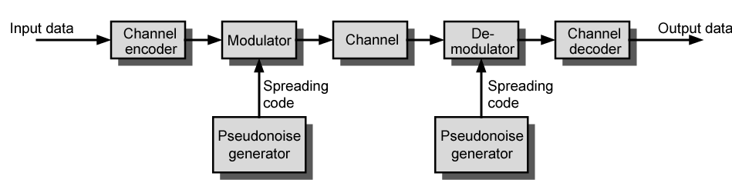
General Model of Spread Spectrum System

Slide 9
Gains
Immunity from various noise and multipath distortion
  Including jamming
Can hide/encrypt signals
  Only receiver who knows spreading code can retrieve signal
Several users can share same higher bandwidth with little interference
  Cellular telephones
  Code division multiplexing (CDM)
  Code division multiple access (CDMA)

Slide 10
Pseudorandom Numbers
Generated by algorithm using initial seed
Deterministic algorithm
  Not actually random
  If algorithm good, results pass reasonable tests of randomness
Need to know algorithm and seed to predict sequence

Slide 11
Frequency Hopping Spread Spectrum (FHSS)
Signal broadcast over seemingly random series of frequencies
Receiver hops between frequencies in sync with transmitter
Eavesdroppers hear unintelligible blips
Jamming on one frequency affects only a few bits

Slide 12
Basic Operation
Typically 2^{k} carriers frequencies forming 2^{k} channels
Channel spacing corresponds with bandwidth of input
Each channel used for fixed interval
  300 ms in IEEE 802.11
  Some number of bits transmitted using some encoding scheme
    May be fractions of bit (see later)
  Sequence dictated by spreading code

Slide 13
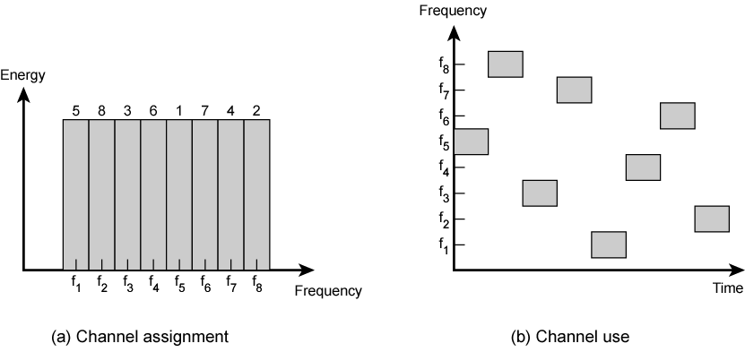
Frequency Hopping Example

Slide 14
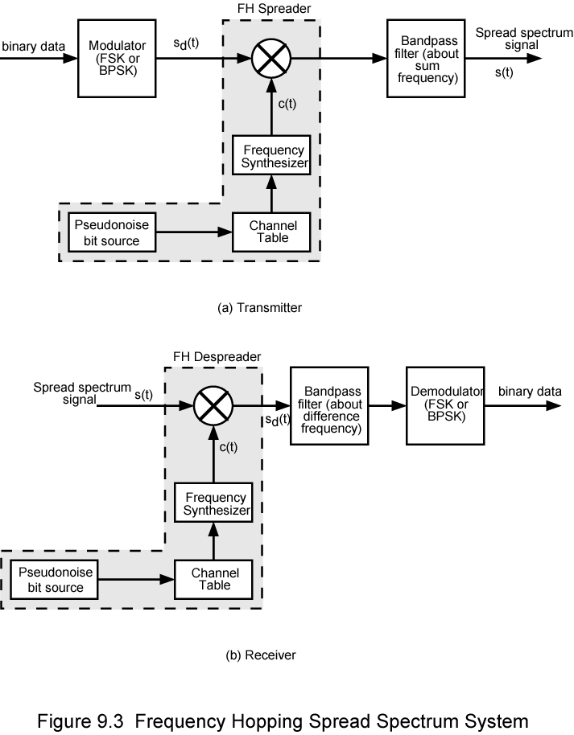
Frequency Hopping Spread Spectrum System (Transmitter)

Slide 15
Frequency Hopping Spread Spectrum System (Receiver)

Slide 16
Slow and Fast FHSS
Frequency shifted every T_{c} seconds
Duration of signal element is T_{s} seconds
Slow FHSS has T_{c} ≥ T_{s}
Fast FHSS has T_{c} < T_{s}
Generally fast FHSS gives improved performance in noise (or jamming)

Slide 17
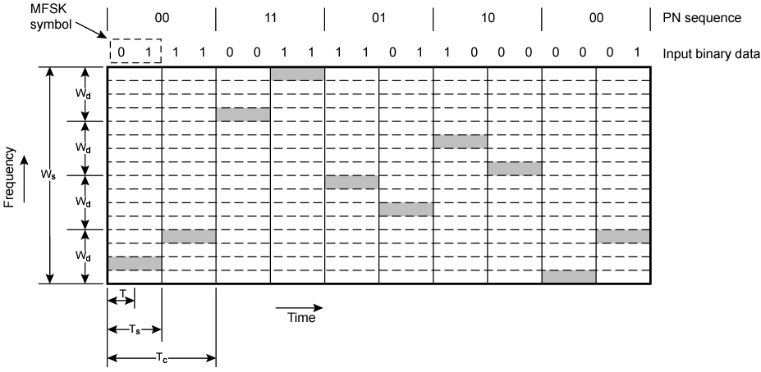
Slow Frequency Hop Spread Spectrum Using MFSK (M=4, k=2)

Slide 18
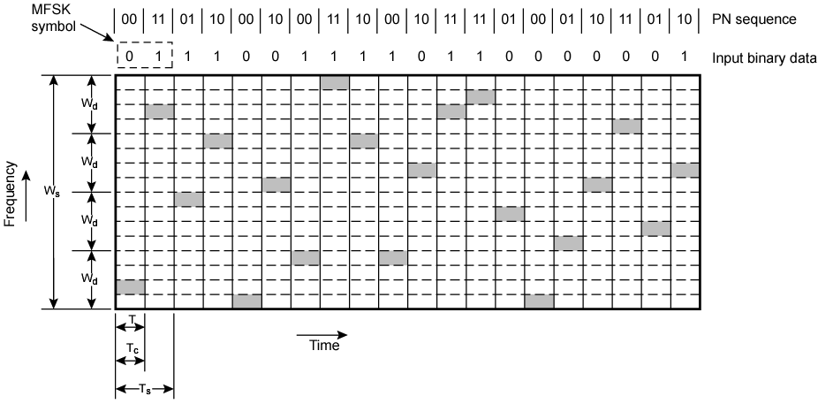
Fast Frequency Hop Spread Spectrum Using MFSK (M=4, k=2)

Slide 19
FHSS Performance Considerations
Typically large number of frequencies used
  Improved resistance to jamming

Slide 20
Direct Sequence Spread Spectrum (DSSS)
Each bit represented by multiple bits using spreading code
Spreading code spreads signal across wider frequency band
  In proportion to number of bits used
  10 bit spreading code spreads signal across 10 times bandwidth of 1 bit code
One method:
  Combine input with spreading code using XOR
  Input bit 1 inverts spreading code bit
  Input zero bit doesn’t alter spreading code bit
  Data rate equal to original spreading code
Performance similar to FHSS

Slide 21
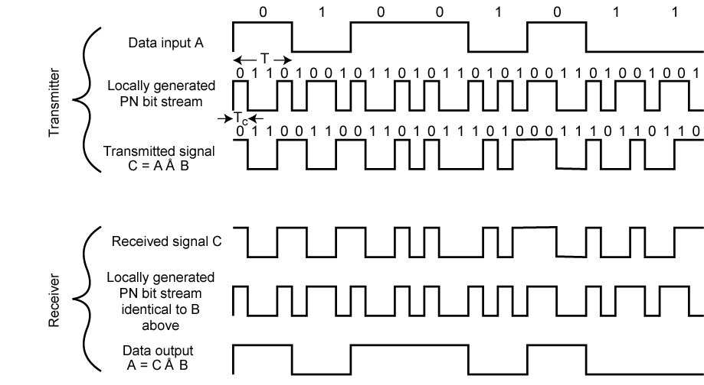
Direct Sequence Spread Spectrum Example

Slide 22
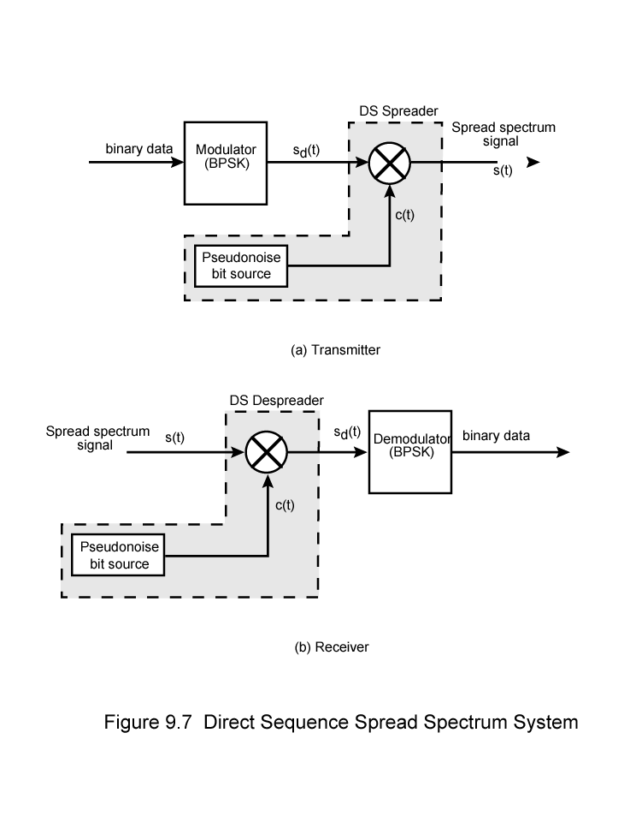
Direct Sequence Spread Spectrum Transmitter

Slide 23
Direct Sequence Spread Spectrum Transmitter

Slide 24
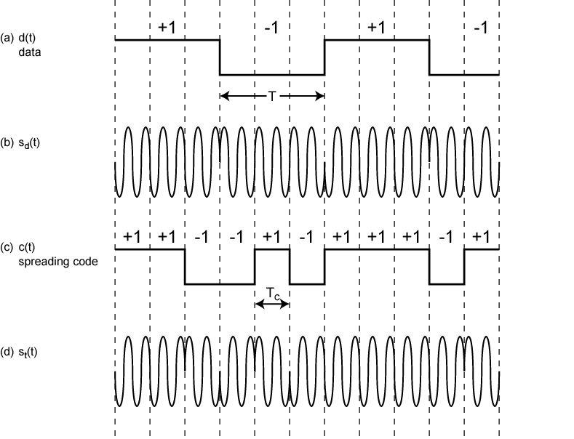
Direct Sequence Spread Spectrum Using BPSK Example

Slide 25
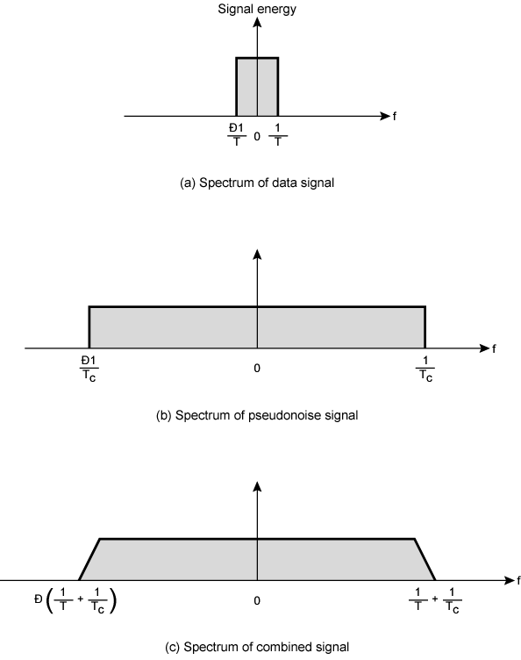
Approximate
Spectrum of
DSSS Signal

Slide 26
CDMA in DSSS Environment
n users each using different orthogonal PN sequence
Modulate each users data stream
  Using BPSK
Multiply by spreading code of user

Slide 27
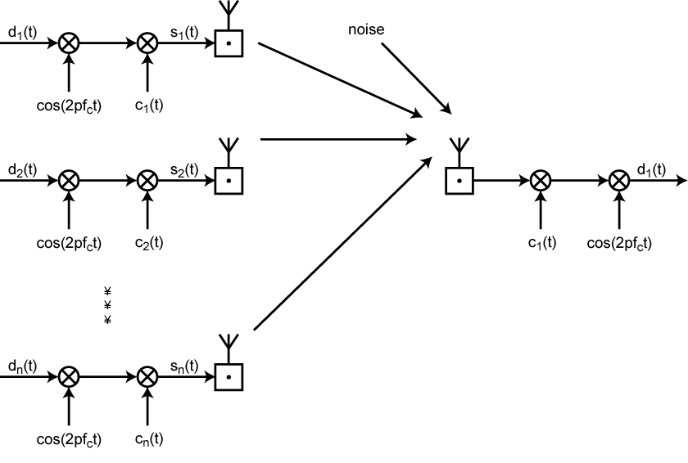
CDMA in a DSSS Environment

